Slide 1
Capston project MD. SHOHEL ARMAN Department of Software Engineering, Daffodil International University

Slide 2
Dynamite Name: Simanta Kumar Roy ID: 221-35-909 Name: Sudip Datta ID: 221-35-880

Slide 3
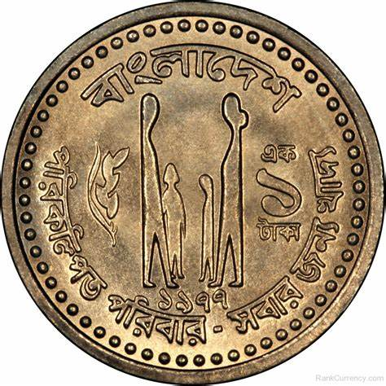
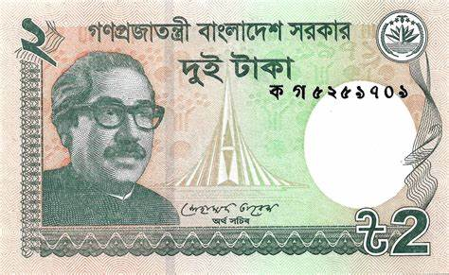
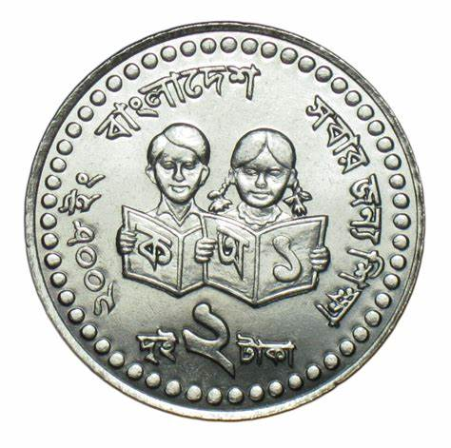
The Central Bank of DSC

Slide 4
Introduction :
In our day to day life, we all have face a problem, what is shortage of coin. Like we buy a product that is 102 taka , But we have available 100 taka note , But shortage of 2 taka coin. In this project we are going to Launch a E-coin name DIU COIN .
How it Works ?
In this System All user have an account . Suppose a customer buy a product that is 108 taka , So we need to manage 1 five taka coin and a 2 one taka coin and 1 taka coin, total 8 DIU-COIN will be added on user account.
We are going to calculate total due of merchant and customer and convert DIU-COIN to taka . And distribute them.

Slide 5
TYPE OF USER
SUPER ADMIN ( Bank Staff )
Merchant Users
Customer Users

Slide 6
User Assessablity
Super Admin
Transfer Balance .
Register Merchant User.
Register Customer User.
Register COIN .
Merchant User
Cash In.
Cash Out.
Register Customer User.
Merchant user can show their Profile and balance .
Customer User
Customer User can show their balance .
They can Change their Password.

Slide 7
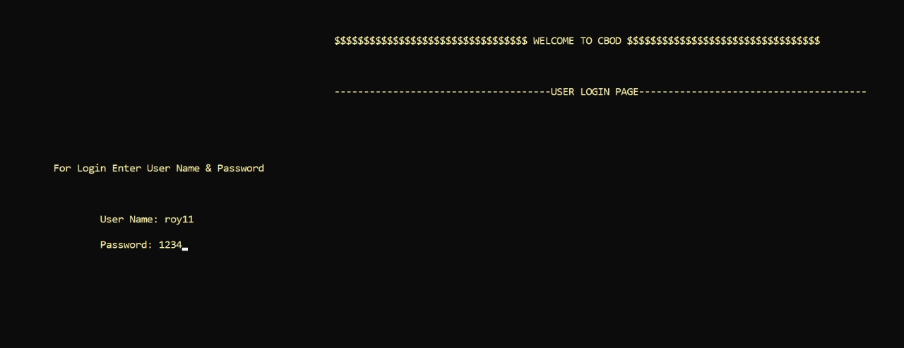
Implementation
Homepage:

Slide 8
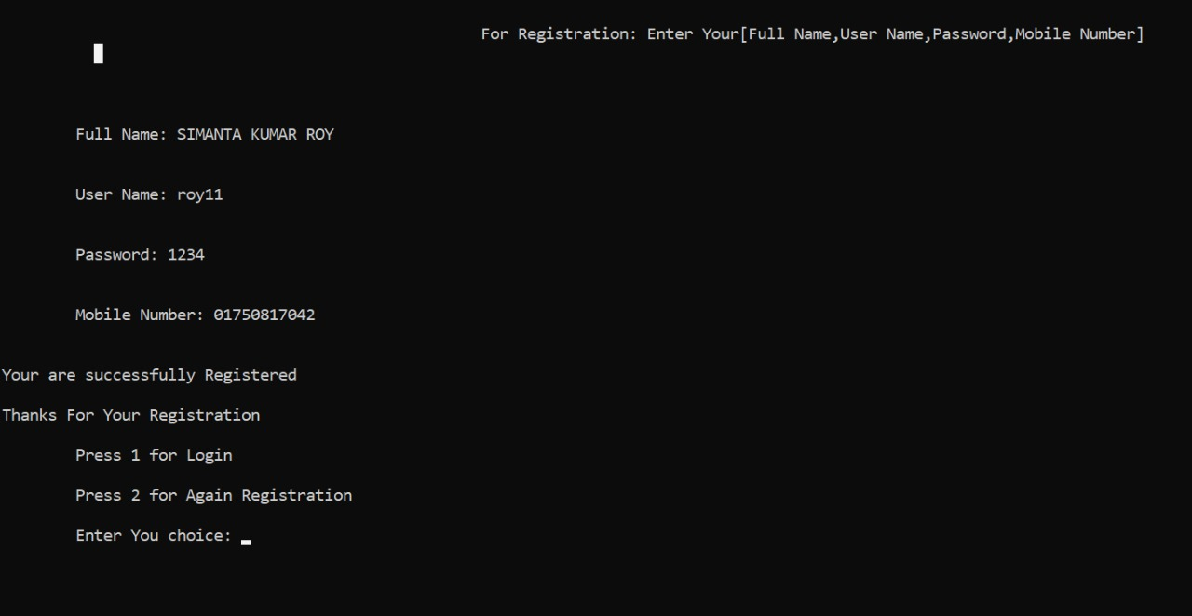
Registation page:

Slide 9
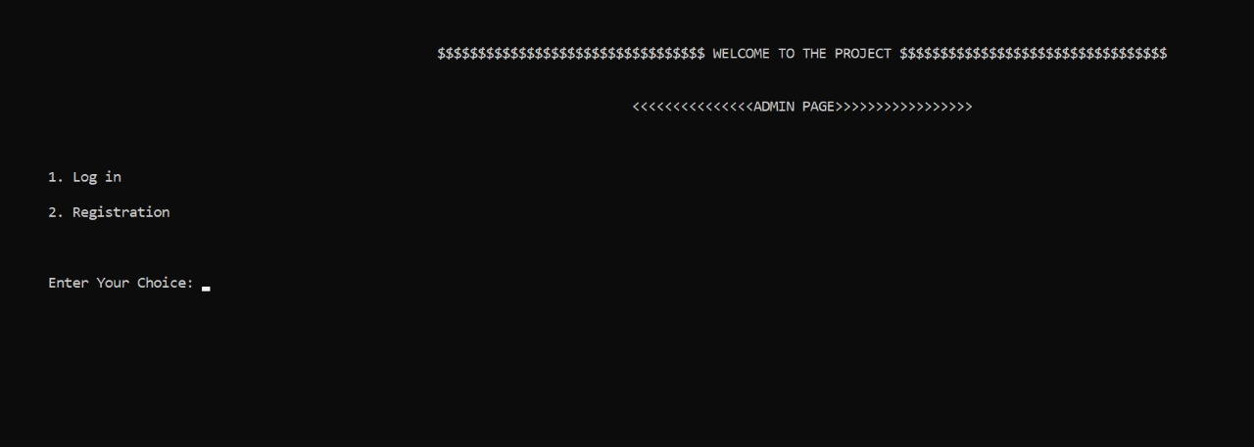
Login page

Slide 10
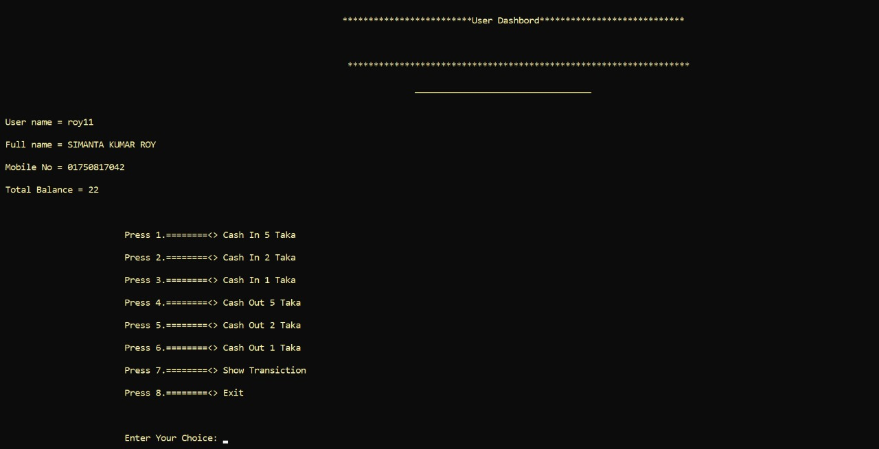
User Dashboard

Slide 11
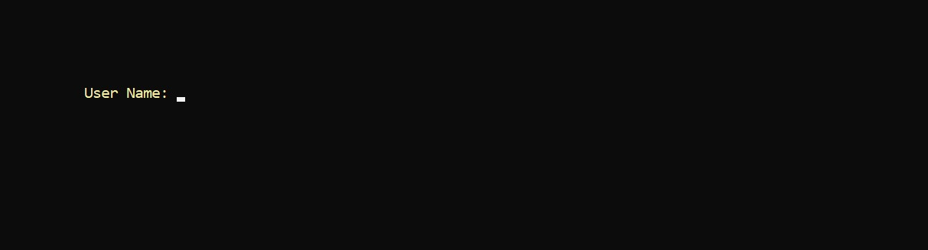
Customer Details:

Slide 12
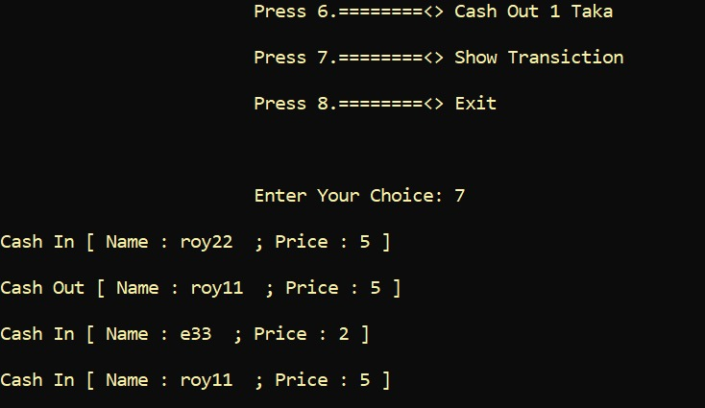
Cash in/ Cash out:

Slide 13
